Slide 1
SOFTWARE REQUIREMENT ENGINEERING
WEEK 3
Dr. Mirza Shuja
Assistant Professor
SCA LPU

Slide 2
REQUIREMENTS ENGINEERING
The process of establishing the services that the customer requires from a system and the constraints under which it operates and is developed
The requirements themselves are the descriptions of the system services and constraints that are generated during the requirements engineering process

Slide 3
WHAT IS A REQUIREMENT?
It may range from a high-level abstract statement of a service or of a system constraint to a detailed mathematical functional specification
This is inevitable as requirements may serve a dual function
  May be the basis for a bid for a contract - therefore must be open to interpretation
  May be the basis for the contract itself - therefore must be defined in detail
  Both these statements may be called requirements

Slide 4
TYPES OF REQUIREMENT
User requirements
  Statements in natural language plus diagrams of the services the system provides and its operational constraints. Written for customers
System requirements
  A structured document setting out detailed descriptions of the system services. Written as a contract between client and contractor
Software specification
  A detailed software description which can serve as a basis for a design or implementation. Written for developers

Slide 5
FUNCTIONAL AND NON-FUNCTIONAL REQUIREMENTS
Functional requirements
  Statements of services the system should provide, how the system should react to particular inputs and how the system should behave in particular situations.
Non-functional requirements
  constraints on the services or functions offered by the system such as timing constraints, constraints on the development process, standards, etc.
Domain requirements
  Requirements that come from the application domain of the system and that reflect characteristics of that domain

Slide 6
FUNCTIONAL REQUIREMENTS
Describe functionality or system services
Depend on the type of software, expected users and the type of system where the software is used
Functional user requirements may be high-level statements of what the system should do but functional system requirements should describe the system services in detail

Slide 7
NON-FUNCTIONAL REQUIREMENTS
Define system properties and constraints e.g. reliability, response time and storage requirements. Constraints are I/O device capability, system representations, etc.
Process requirements may also be specified mandating a particular CASE system, programming language or development method
Non-functional requirements may be more critical than functional requirements. If these are not met, the system is useless

Slide 8
NON-FUNCTIONAL CLASSIFICATIONS
Product requirements
  Requirements which specify that the delivered product must behave in a particular way e.g. execution speed, reliability, etc.
Organisational requirements
  Requirements which are a consequence of organisational policies and procedures e.g. process standards used, implementation requirements, etc.
External requirements
  Requirements which arise from factors which are external to the system and its development process e.g. interoperability requirements, legislative requirements, etc.

Slide 9
REQUIREMENTS COMPLETENESS AND CONSISTENCY
Problems arise when requirements are not precisely stated
Ambiguous requirements may be interpreted in different ways by developers and users
In principle requirements should be both complete and consistent
Complete
  They should include descriptions of all facilities required
Consistent
  There should be no conflicts or contradictions in the descriptions of the system facilities
In practice, it is impossible to produce a complete and consistent requirements document

Slide 10
THE PROBLEMS WITH OUR REQUIREMENTS PRACTICES
We have trouble understanding the requirements that we do acquire from the customer
We often record requirements in a disorganized manner
We spend far too little time verifying what we do record
We allow change to control us, rather than establishing mechanisms to control change
Most importantly, we fail to establish a solid foundation for the system or software that the user wants built

Slide 11
THE PROBLEMS WITH OUR REQUIREMENTS PRACTICES (CONTINUED)
Many software developers argue that
  Building software is so compelling that we want to jump right in (before having a clear understanding of what is needed)
  Things will become clear as we build the software
  Project stakeholders will be able to better understand what they need only after examining early iterations of the software
  Things change so rapidly that requirements engineering is a waste of time
  The bottom line is producing a working program and that all else is secondary
All of these arguments contain some truth, especially for small projects that take less than one month to complete
However, as software grows in size and complexity, these arguments begin to break down and can lead to a failed software project

Slide 12
A SOLUTION: REQUIREMENTS ENGINEERING
Begins during the communication activity and continues into the modeling activity
Builds a bridge from the system requirements into software design and construction
Allows the requirements engineer to examine
  the context of the software work to be performed
  the specific needs that design and construction must address
  the priorities that guide the order in which work is to be completed
  the information, function, and behavior that will have a profound impact on the resultant design

Slide 13
REQUIREMENTS ENGINEERING TASKS
Seven distinct tasks
  Inception
  Elicitation
  Elaboration
  Negotiation
  Specification
  Validation
  Requirements Management
Some of these tasks may occur in parallel and all are adapted to the needs of the project
All strive to define what the customer wants
All serve to establish a solid foundation for the design and construction of the software

Slide 14
REQUIREMENTS ENGINEERING TASKS
Inception—ask a set of questions that establish …
  basic understanding of the problem
  the people who want a solution
  the nature of the solution that is desired, and
  the effectiveness of preliminary communication and collaboration between the customer and the developer
Elicitation—elicit requirements from all stakeholders
Elaboration—create an analysis model that identifies data, function and behavioral requirements
Negotiation—agree on a deliverable system that is realistic for developers and customers

Slide 15
Specification—can be any one (or more) of the following:
  A written document
  A set of models
  A formal mathematical
  A collection of user scenarios (use-cases)
  A prototype
Validation—a review mechanism that looks for
  errors in content or interpretation
  areas where clarification may be required
  missing information
  inconsistencies (a major problem when large products or systems are engineered)
  conflicting or unrealistic (unachievable) requirements.
Requirements management
Some of these tasks may occur in parallel and all are adapted to the needs of the project
All strive to define what the customer wants
All serve to establish a solid foundation for the design and construction of the software

Slide 16
Inception
Elicitation
Elaboration
Negotiation
Specification
Validation
Requirements
Management

Slide 17
INCEPTION TASK
During inception, the requirements engineer asks a set of questions to establish…
  A basic understanding of the problem
  The people who want a solution
  The nature of the solution that is desired
  The effectiveness of preliminary communication and collaboration between the customer and the developer
Through these questions, the requirements engineer needs to…
  Identify the stakeholders
  Recognize multiple viewpoints
  Work toward collaboration
  Break the ice and initiate the communication

Slide 18
Inception
Elicitation
Elaboration
Negotiation
Specification
Validation
Requirements
Management

Slide 19
ELICITATION TASK
Eliciting requirements is difficult because of
  Problems of scope in identifying the boundaries of the system or specifying too much technical detail rather than overall system objectives
  Problems of understanding what is wanted, what the problem domain is, and what the computing environment can handle (Information that is believed to be "obvious" is often omitted)
  Problems of volatility because the requirements change over time
Elicitation may be accomplished through two activities
  Collaborative requirements gathering
  Quality function deployment

Slide 20
BASIC GUIDELINES OF COLLABORATIVE REQUIREMENTS GATHERING
Meetings are conducted and attended by both software engineers, customers, and other interested stakeholders
Rules for preparation and participation are established
An agenda is suggested that is formal enough to cover all important points but informal enough to encourage the free flow of ideas
A "facilitator" (customer, developer, or outsider) controls the meeting
A "definition mechanism" is used such as work sheets, flip charts, wall stickers, electronic bulletin board, chat room, or some other virtual forum
The goal is to identify the problem, propose elements of the solution, negotiate different approaches, and specify a preliminary set of solution requirements

Slide 21
QUALITY FUNCTION DEPLOYMENT
This is a technique that translates the needs of the customer into technical requirements for software
It emphasizes an understanding of what is valuable to the customer and then deploys these values throughout the engineering process through functions, information, and tasks
It identifies three types of requirements
  Normal requirements: These requirements are the objectives and goals stated for a product or system during meetings with the customer
  Expected requirements: These requirements are implicit to the product or system and may be so fundamental that the customer does not explicitly state them
  Exciting requirements: These requirements are for features that go beyond the customer's expectations and prove to be very satisfying when present

Slide 22
ELICITATION WORK PRODUCTS
The work products will vary depending on the system, but should include one or more of the following items
A statement of need and feasibility
A bounded statement of scope for the system or product
A list of customers, users, and other stakeholders who participated in requirements elicitation
A description of the system's technical environment
A list of requirements (organized by function) and the domain constraints that apply to each
A set of preliminary usage scenarios (in the form of use cases) that provide insight into the use of the system or product under different operating conditions
Any prototypes developed to better define requirements

Slide 23
Inception
Elicitation
Elaboration
Negotiation
Specification
Validation
Requirements
Management

Slide 24
ELABORATION TASK
During elaboration, the software engineer takes the information obtained during inception and elicitation and begins to expand and refine it
Elaboration focuses on developing a refined technical model of software functions, features, and constraints
It is an analysis modeling task
  Use cases are developed
  Domain classes are identified along with their attributes and relationships
  State machine diagrams are used to capture the life on an object
The end result is an analysis model that defines the functional, informational, and behavioral domains of the problem

Slide 25
DEVELOPING USE CASES
Step One – Define the set of actors that will be involved in the story
  Actors are people, devices, or other systems that use the system or product within the context of the function and behavior that is to be described
  Actors are anything that communicate with the system or product and that are external to the system itself
Step Two – Develop use cases, where each one answers a set of questions

Slide 26
USE-CASES
A collection of user scenarios that describe the thread of usage of a system
Each scenario is described from the point-of-view of an “actor”—a person or device that interacts with the software in some way
Each scenario answers the following questions:
  Who is the primary actor, the secondary actor (s)?
  What are the actor’s goals?
  What preconditions should exist before the story begins?
  What main tasks or functions are performed by the actor?
  What extensions might be considered as the story is described?
  What variations in the actor’s interaction are possible?
  What system information will the actor acquire, produce, or change?
  Will the actor have to inform the system about changes in the external environment?
  What information does the actor desire from the system?
  Does the actor wish to be informed about unexpected changes?

Slide 27
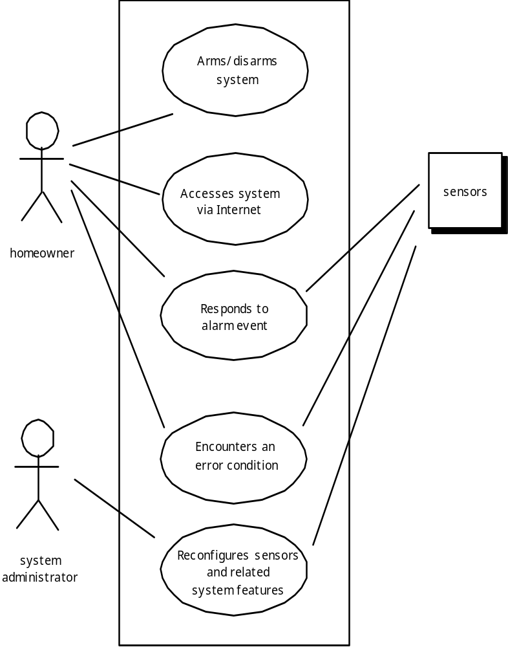
USE-CASE DIAGRAM

Slide 28
ELEMENTS OF THE ANALYSIS MODEL
Scenario-based elements
  Describe the system from the user's point of view using scenarios that are depicted in use cases and activity diagrams
Class-based elements
  Identify the domain classes for the objects manipulated by the actors, the attributes of these classes, and how they interact with one another; they utilize class diagrams to do this
Behavioral elements
  Use state diagrams to represent the state of the system, the events that cause the system to change state, and the actions that are taken as a result of a particular event; can also be applied to each class in the system
Flow-oriented elements
  Use data flow diagrams to show the input data that comes into a system, what functions are applied to that data to do transformations, and what resulting output data are produced

Slide 29
Inception
Elicitation
Elaboration
Negotiation
Specification
Validation
Requirements
Management

Slide 30
NEGOTIATION TASK
During negotiation, the software engineer reconciles the conflicts between what the customer wants and what can be achieved given limited business resources
Requirements are ranked (i.e., prioritized) by the customers, users, and other stakeholders
Risks associated with each requirement are identified and analyzed
Rough guesses of development effort are made and used to assess the impact of each requirement on project cost and delivery time
Using an iterative approach, requirements are eliminated, combined and/or modified so that each party achieves some measure of satisfaction

Slide 31
THE ART OF NEGOTIATION
Recognize that it is not competition
Map out a strategy
Listen actively
Focus on the other party’s interests
Don’t let it get personal
Be creative
Be ready to commit

Slide 32
Inception
Elicitation
Elaboration
Negotiation
Specification
Validation
Requirements
Management

Slide 33
SPECIFICATION TASK
A specification is the final work product produced by the requirements engineer
It is normally in the form of a software requirements specification
It serves as the foundation for subsequent software engineering activities
It describes the function and performance of a computer-based system and the constraints that will govern its development
It formalizes the informational, functional, and behavioral requirements of the proposed software in both a graphical and textual format

Slide 34
TYPICAL CONTENTS OF A SOFTWARE REQUIREMENTS SPECIFICATION
Requirements
  Required states and modes
  Software requirements grouped by capabilities (i.e., functions, objects)
  Software external interface requirements
  Software internal interface requirements
  Software internal data requirements
  Other software requirements (safety, security, privacy, environment, hardware, software, communications, quality, personnel, training, logistics, etc.)
  Design and implementation constraints
Qualification provisions to ensure each requirement has been met
  Demonstration, test, analysis, inspection, etc.
Requirements traceability
  Trace back to the system or subsystem where each requirement applies

Slide 35
THE SOFTWARE REQUIREMENTS DOCUMENT
The software requirements document is the official statement of what is required of the system developers.
Should include both a definition of user requirements and a specification of the system requirements.
It is NOT a design document. As far as possible, it should set of WHAT the system should do rather than HOW it should do it.

Slide 36
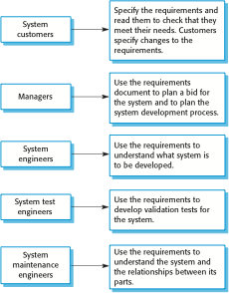
USERS OF A REQUIREMENTS DOCUMENT

Slide 37
REQUIREMENTS DOCUMENT VARIABILITY
Information in requirements document depends on type of system and the approach to development used.
Systems developed incrementally will, typically, have less detail in the requirements document.
Requirements documents standards have been designed e.g. IEEE standard. These are mostly applicable to the requirements for large systems engineering projects.

Slide 38
THE STRUCTURE OF A REQUIREMENTS DOCUMENT
Chapter | Description
Preface | This should define the expected readership of the document and describe its version history, including a rationale for the creation of a new version and a summary of the changes made in each version.
Introduction | This should describe the need for the system. It should briefly describe the system’s functions and explain how it will work with other systems. It should also describe how the system fits into the overall business or strategic objectives of the organization commissioning the software.
Glossary | This should define the technical terms used in the document. You should not make assumptions about the experience or expertise of the reader.
User requirements definition | Here, you describe the services provided for the user. The nonfunctional system requirements should also be described in this section. This description may use natural language, diagrams, or other notations that are understandable to customers. Product and process standards that must be followed should be specified.
System architecture | This chapter should present a high-level overview of the anticipated system architecture, showing the distribution of functions across system modules. Architectural components that are reused should be highlighted.

Slide 39
THE STRUCTURE OF A REQUIREMENTS DOCUMENT
Chapter | Description
System requirements specification | This should describe the functional and nonfunctional requirements in more detail. If necessary, further detail may also be added to the nonfunctional requirements. Interfaces to other systems may be defined.
System models | This might include graphical system models showing the relationships between the system components and the system and its environment. Examples of possible models are object models, data-flow models, or semantic data models.
System evolution | This should describe the fundamental assumptions on which the system is based, and any anticipated changes due to hardware evolution, changing user needs, and so on. This section is useful for system designers as it may help them avoid design decisions that would constrain likely future changes to the system.
Appendices | These should provide detailed, specific information that is related to the application being developed; for example, hardware and database descriptions. Hardware requirements define the minimal and optimal configurations for the system. Database requirements define the logical organization of the data used by the system and the relationships between data.
Index | Several indexes to the document may be included. As well as a normal alphabetic index, there may be an index of diagrams, an index of functions, and so on.

Slide 40
REQUIREMENTS SPECIFICATION
The process of writing don the user and system requirements in a requirements document.
User requirements have to be understandable by end-users and customers who do not have a technical background.
System requirements are more detailed requirements and may include more technical information.
The requirements may be part of a contract for the system development
  It is therefore important that these are as complete as possible.

Slide 41
WAYS OF WRITING A SYSTEM REQUIREMENTS SPECIFICATION
Notation | Description
Natural language | The requirements are written using numbered sentences in natural language. Each sentence should express one requirement.
Structured natural language | The requirements are written in natural language on a standard form or template. Each field provides information about an aspect of the requirement.
Design description languages | This approach uses a language like a programming language, but with more abstract features to specify the requirements by defining an operational model of the system. This approach is now rarely used although it can be useful for interface specifications.
Graphical notations | Graphical models, supplemented by text annotations, are used to define the functional requirements for the system; UML use case and sequence diagrams are commonly used.
Mathematical specifications | These notations are based on mathematical concepts such as finite-state machines or sets. Although these unambiguous specifications can reduce the ambiguity in a requirements document, most customers don’t understand a formal specification. They cannot check that it represents what they want and are reluctant to accept it as a system contract

Slide 42
REQUIREMENTS AND DESIGN
In principle, requirements should state what the system should do and the design should describe how it does this.
In practice, requirements and design are inseparable
  A system architecture may be designed to structure the requirements;
  The system may inter-operate with other systems that generate design requirements;
  The use of a specific architecture to satisfy non-functional requirements may be a domain requirement.
  This may be the consequence of a regulatory requirement.

Slide 43
NATURAL LANGUAGE SPECIFICATION
Requirements are written as natural language sentences supplemented by diagrams and tables.
Used for writing requirements because it is expressive, intuitive and universal. This means that the requirements can be understood by users and customers.

Slide 44
GUIDELINES FOR WRITING REQUIREMENTS
Invent a standard format and use it for all requirements.
Use language in a consistent way. Use shall for mandatory requirements, should for desirable requirements.
Use text highlighting to identify key parts of the requirement.
Avoid the use of computer jargon.
Include an explanation (rationale) of why a requirement is necessary.

Slide 45
Inception
Elicitation
Elaboration
Negotiation
Specification
Validation
Requirements
Management

Slide 46
VALIDATION TASK
During validation, the work products produced as a result of requirements engineering are assessed for quality
The specification is examined to ensure that
  all software requirements have been stated unambiguously
  inconsistencies, omissions, and errors have been detected and corrected
  the work products conform to the standards established for the process, the project, and the product
The formal technical review serves as the primary requirements validation mechanism
  Members include software engineers, customers, users, and other stakeholders

Slide 47
REQUIREMENTS VALIDATION TECHNIQUES
Requirements reviews
  Systematic manual analysis of the requirements.
Prototyping
  Using an executable model of the system to check requirements.
Test-case generation
  Developing tests for requirements to check testability.

Slide 48
VALIDATING REQUIREMENTS
Is each requirement consistent with the overall objective for the system/product?
Have all requirements been specified at the proper level of abstraction? That is, do some requirements provide a level of technical detail that is inappropriate at this stage?
Is the requirement really necessary or does it represent an add-on feature that may not be essential to the objective of the system?
Is each requirement bounded and unambiguous?
Does each requirement have attribution? That is, is a source (generally, a specific individual) noted for each requirement?
Do any requirements conflict with other requirements?

Slide 49
Inception
Elicitation
Elaboration
Negotiation
Specification
Validation
Requirements
Management

Slide 50
REQUIREMENTS MANAGEMENT
Requirements management is the process of managing changing requirements during the requirements engineering process and system development.
New requirements emerge as a system is being developed and after it has gone into use.
You need to keep track of individual requirements and maintain links between dependent requirements so that you can assess the impact of requirements changes. You need to establish a formal process for making change proposals and linking these to system requirements.

Slide 51
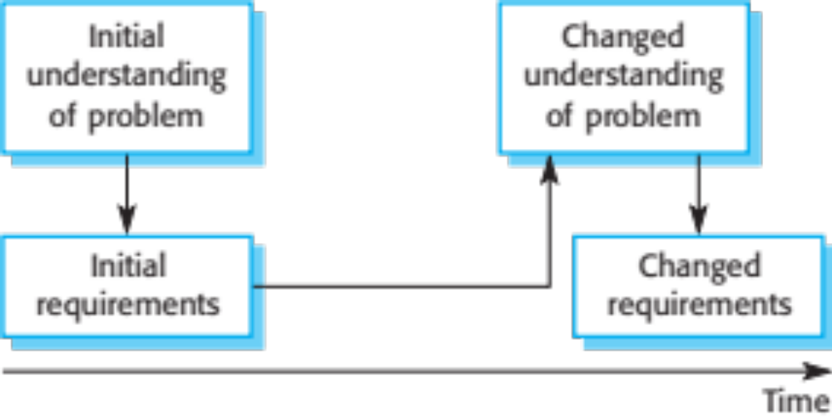
REQUIREMENTS EVOLUTION

Slide 52
REQUIREMENTS MANAGEMENT PLANNING
Establishes the level of requirements management detail that is required.
Requirements management decisions:
  Requirements identification Each requirement must be uniquely identified so that it can be cross-referenced with other requirements.
  A change management process This is the set of activities that assess the impact and cost of changes. I discuss this process in more detail in the following section.
  Traceability policies These policies define the relationships between each requirement and between the requirements and the system design that should be recorded.
  Tool support Tools that may be used range from specialist requirements management systems to spreadsheets and simple database systems.

Slide 53
REQUIREMENTS CHANGE MANAGEMENT
Deciding if a requirements change should be accepted
  Problem analysis and change specification
    During this stage, the problem or the change proposal is analyzed to check that it is valid. This analysis is fed back to the change requestor who may respond with a more specific requirements change proposal, or decide to withdraw the request.
  Change analysis and costing
    The effect of the proposed change is assessed using traceability information and general knowledge of the system requirements. Once this analysis is completed, a decision is made whether or not to proceed with the requirements change.
  Change implementation
    The requirements document and, where necessary, the system design and implementation, are modified. Ideally, the document should be organized so that changes can be easily implemented.

Slide 54
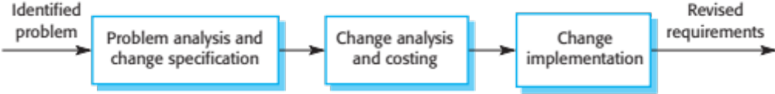
REQUIREMENTS CHANGE MANAGEMENT

Slide 55
ANY QUERIES ????

